Slide 1

DASIL Python Workshop #5
2022-05-05
Hadoop & Spark
Martin Pollack – DASIL Student Mentor
Christopher Moppel – DASIL Student Mentor
Yusen He, PhD – Lead Data Scientist, DASIL

Slide 2
Agenda
Hadoop
Hadoop Distributed File System
MapReduce Paradigm
YARN Resource Manager
Spark
DataFrames
PySpark

Slide 3
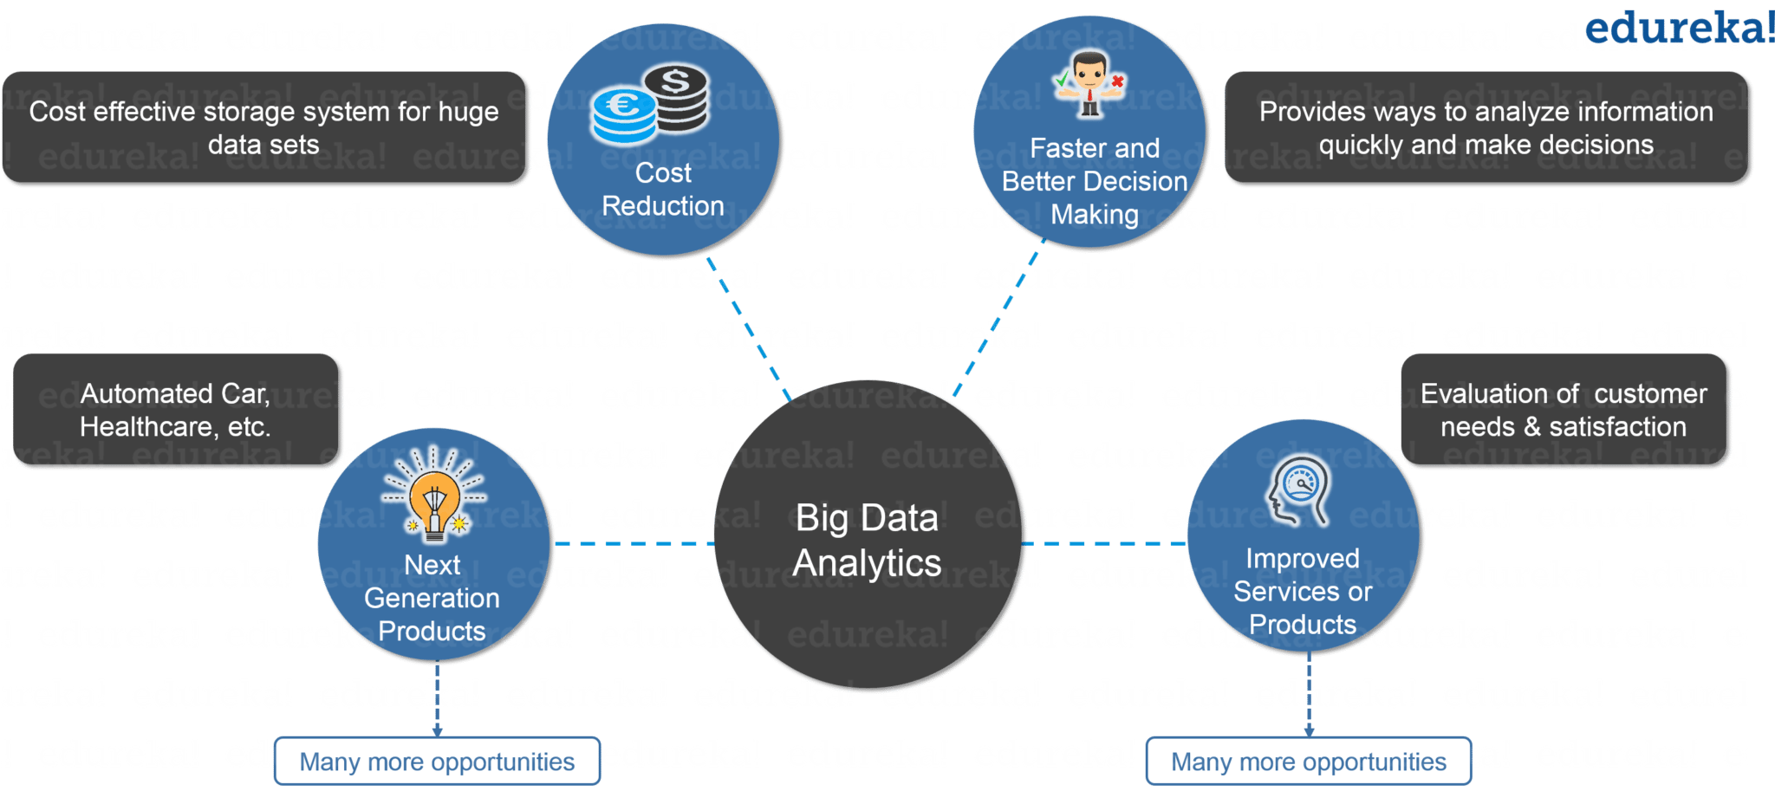
Motivation for Hadoop
Big Data is amazing
More detailed insight
Better predictions
However, potential problems are...
Storing the colossal amount of data
Accessing and processing it quickly
Image Credit: https://www.edureka.co/blog/what-is-hadoop/

Slide 4
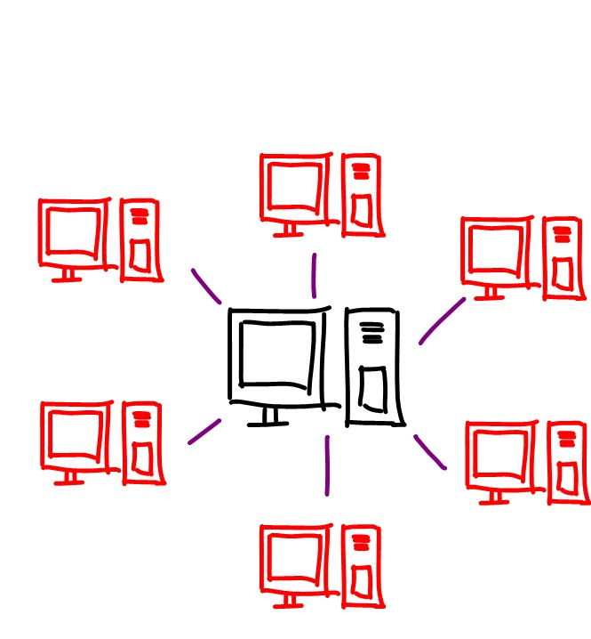
Terms and Definitions
When data gets big, it cannot all fit on one computer
Imagine trying to get all Amazon purchases from last month on your laptop...
Instead, we can spread out our data on multiple computers that are connected (distributed computing)
We call a connected group of computers a cluster
A specific computer is called a node
Image Credit: https://i.ytimg.com/vi/YS-QvfCZWvc/maxresdefault.jpg

Slide 5
What is Hadoop?
An open-source framework that allows you to store lots of data in a distributed environment so that you can process the data in parallel.
Usually cheap, older computers are used to save costs. In case they fail, you can replicate your data on multiple nodes.
Three components in Hadoop:
Storage: Hadoop Distributed File System (HDFS)
Processing: MapReduce
Resource Management: YARN

Slide 6
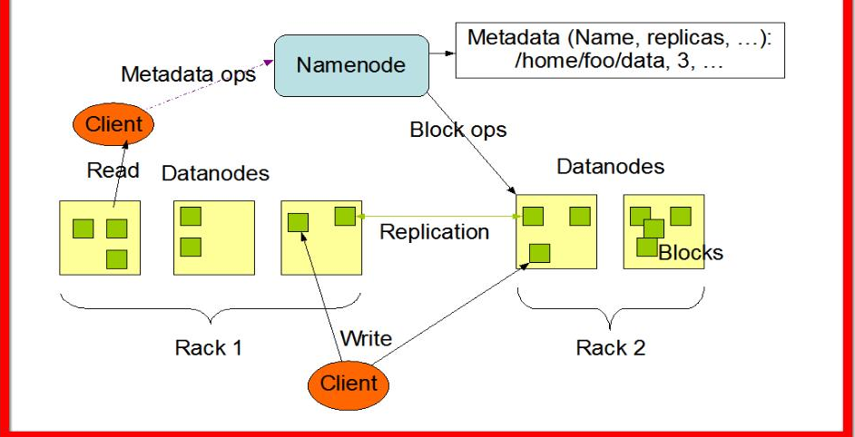
Hadoop Distributed File System – Architecture
How data is stored in a Hadoop cluster
Each cluster has 1 namenode which gives information about the system (# of nodes/replications)
Data is actually stored in datanodes which are grouped together into racks
Files are broken up into blocks, replicated, and put on multiple nodes
Image Credit:http://bigdataweek.com/wp-content/uploads/2013/11/HDFS-Architecture.jpg

Slide 7
MapReduce Paradigm
Main way to process data stored in HDFS
Consists of 3 steps:
Map: apply a function to each node
Shuffle/sort: re-order outputs
Reduce: combine outputs
Done by writing a computer program (usually in Java)
Scalable: easy to add an extra node
Fast: data is processed where it is stored

Slide 8
MapReduce for Word Count
Input
Splitting
Mapping
Shuffling
Reducing
Final Result
Martin Yusen Julia
Martin, 1
Yusen, 1
Julia, 1
Martin, 1
Martin, 2
Martin, 3
Yusen, 1
Yusen, 1
Yusen, 2
Martin Yusen Julia
Chris Julia Yusen
Martin Martin Chris
Chris Julia Yusen
Chris, 1
Julia, 1
Yusen, 1
Martin, 3
Yusen, 2
Julia, 2
Chris, 2
Julia, 1
Julia, 1
Julia, 2
Martin Martin Chris
Martin, 2
Chris, 1
Chris, 1
Chris, 1
Chris, 2

Slide 9
MapReduce Practice (From IBM)
You have Hadoop nodes with data on cities and their temperatures
e.g. (San Francisco, 76)
Each node has data for multiple cities
How could you use MapReduce to find the highest temperature in each city?
Remember: Map, Shuffle, Reduce
(San Francisco, 76)
(Grinnell, -10)
(Grinnell, 20)
(Boston, 42)
(Grinnell, 21)
(Boston, 57)
(Grinnell, 56)
(San Francisco, 72)
(Boston, 65)

Slide 10
MapReduce Practice - Solution
Input
Mapping
Shuffling
Reducing
Final Result
(San Francisco, 76)
(Grinnell, -10)
(Grinnell, 20)
(San Francisco, 76)
(Grinnell, 20)
(Grinnell, 20)
(Grinnell, 21)
(Grinnell, 56)
(Grinnell, 56)
(Boston, 42)
(Grinnell, 21)
(Boston, 57)
(Boston, 57)
(Grinnell, 21)
(San Francisco, 76)
(San Francisco, 72)
(San Francisco, 76)
(Grinnell, 56)
(San Francisco, 76)
(Boston, 65)
(Grinnell, 56)
(San Francisco, 72)
(Boston, 65)
(Grinnell, 56)
(San Francisco, 72)
(Boston, 65)
(Boston, 57)
(Boston, 65)
(Boston, 65)

Slide 11
MapReduce Practice Solution
Map:
For each node, return the max temperature for each city
e.g. (Grinnell, 95) (San Francisco, 85) (Philadelphia, 92)
Shuffle/sort:
Group by city
Reduce:
For each city, find the max temperature from all the node maxes

Slide 12
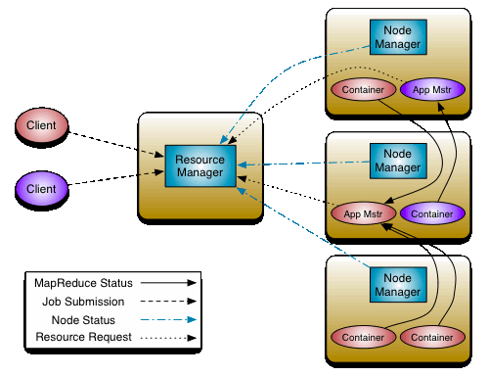
YARN Resource Manager
We may have multiple MapReduce jobs at once
YARN assures everything is as efficient as possible
Multiple components:
Resource Manager: communicate with the client, allocate resources
Node Manager: execute job(s)
Application Master: track a single job, direct Node Managers
Source: Apache Hadoop Docs

Slide 13
Hadoop vs Spark
Spark is newer, seen as an improvement:
Spark data stored in memory (RAM) instead of in a file system
Allows Spark to be up to 100x faster than Hadoop (IBM)!
But better/more expensive computers needed
Hadoop data can only be processed with MapReduce, whereas Spark data can be accessed with SQL-/pandas-like code
Spark is much better at Machine Learning

Slide 14
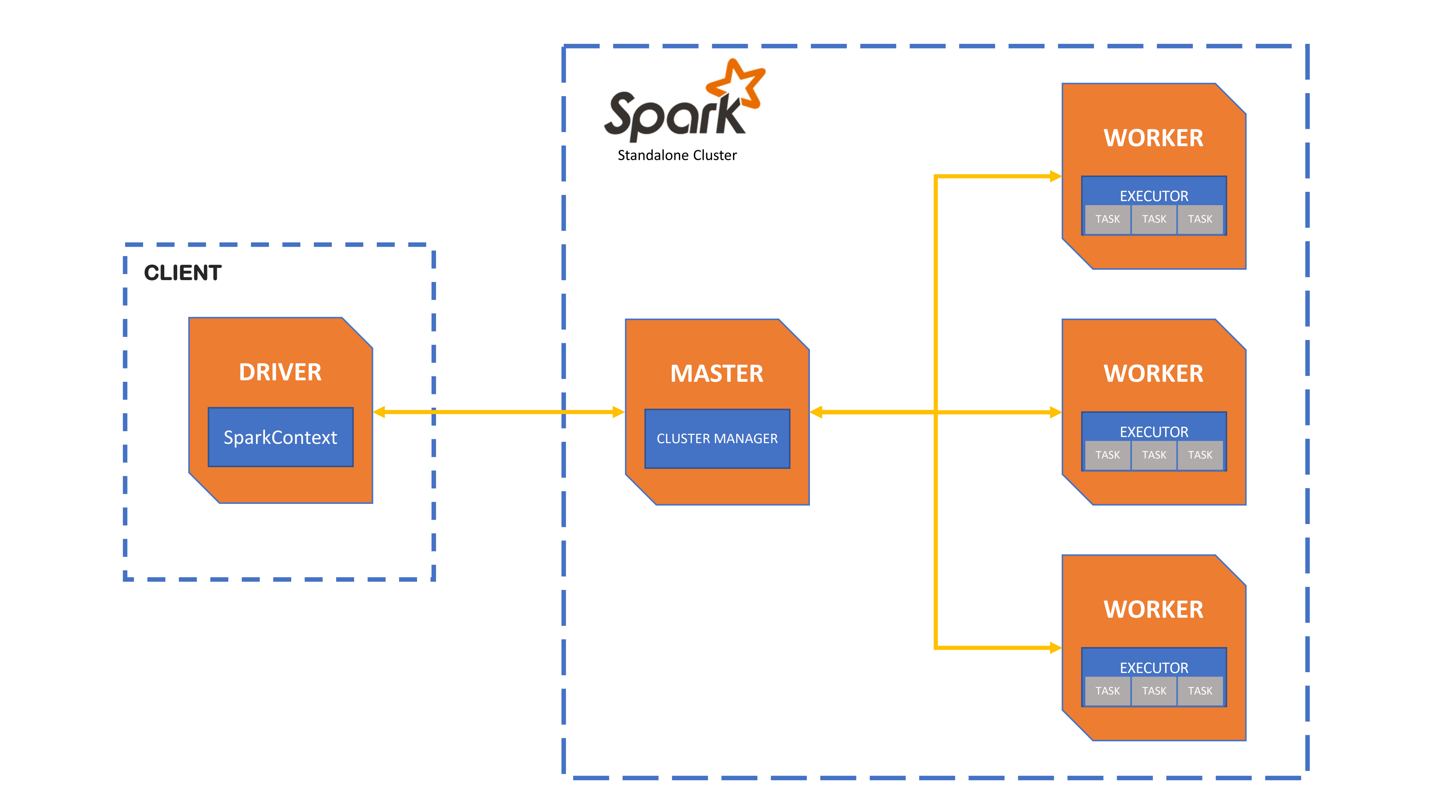
Spark Architecture
New
Source: UCloud

Slide 15
Spark DataFrames
Main way to work with Spark Data
Basically, a relational database "with richer optimizations under the hood" (Apache Spark Docs).
Use the PySpark package in Python (or sparkR in R)
Code very similar to SQL/pandas

Slide 16
So, let's learn PySpark!
Switch to the Jupyter Notebook

